Slide 1
Python - Exceptions Handling
An exception is an error which happens at the time of execution of a program. However, while running a program, Python generates an exception that should be handled to avoid your program to crash. In Python language, exceptions trigger automatically on errors, or they can be triggered and intercepted by the code.
The exception indicates that, although the event can occur, this type of event happens infrequently. When the method is not able to handle the exception, it is thrown to its caller function. Eventually, when an exception is thrown out of the main function, the program is terminated abruptly.

Slide 2
Common Examples of Exception
Division by Zero
Accessing a file which does not exist.
Addition of two incompatible types
Trying to access a nonexistent index of a sequence
Removing the table from the disconnected database server.
ATM withdrawal of more than the available amount

Slide 3
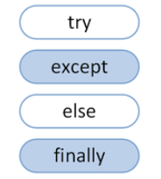
Keywords

Slide 4
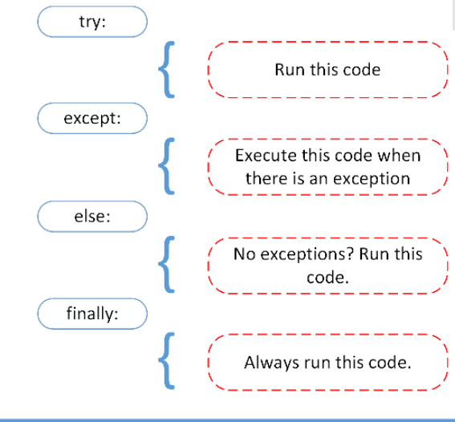
Syntax

Slide 5
Examples
print(2/5))
print(2/0)
print(name)
abc=input()
print(abc1)

Slide 6
try:
print(name)
except NameError as e:
print(e)

Slide 7
#Accessing a variable not present in scope
def nameerror_func():
name="MSRIT"
try:
print(name)
except NameError as e:
print(e)

Slide 8
Programs
Develop a python program to demonstrate handling of following exception using try and except : NameError, Indexerror, KeyError, ZeroDivisionError
Develop a python program to demonstrate handling multiple exception using try and except ,else and finally block statement
Develop a python program to read 5 integer values from the keyboard. Display the sum and average of these numbers. If the user enters any other value, then raise the valueError exception. Display appropriate messages.

Slide 9
Programs
Develop a python program to read the age of a person and display if he is eligible to vote or not. Raise the exception when the age range is less than 1 and greater than 150
Write an interactive program to compute the square root of a number. The input value must be tested for validity. If it is negative, the user defined method MySqrt() should raise an exception
Write a program to simulate saving account processing in a bank using constructors. Create Deposite and Withdraw with other member function and check for validation while withdrawing the amount. Raise the appropriate exceptions when depositing and withdrawing an incorrect amount. Display appropriate messages

